Slide 1
Workplace, Health and Safety for Projects in
ECTE250

Slide 2








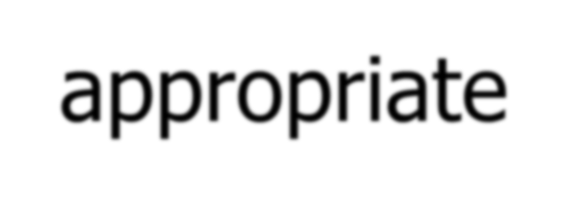


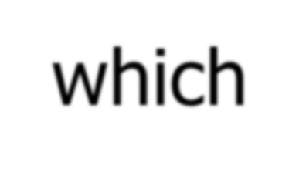

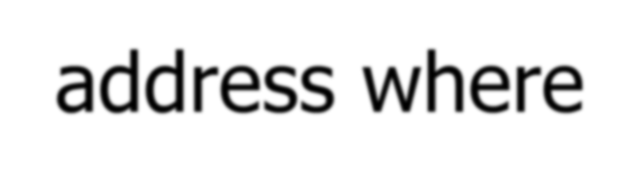

Roles and Responsibilities
AS PER UNIVERSITY’S WHS POLICY
Student
comply with relevant University WHS management system policies, procedures and programs, as appropriate
report any unsafe conditions which
come to their attention and address where possible

Slide 3

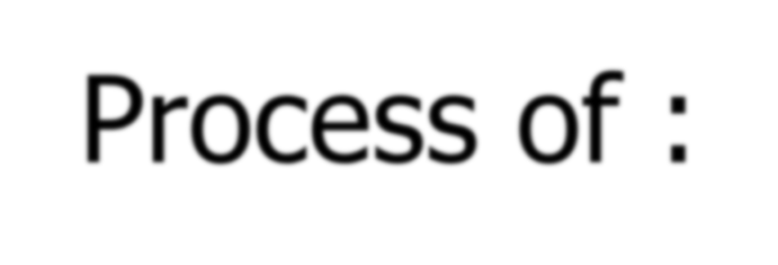

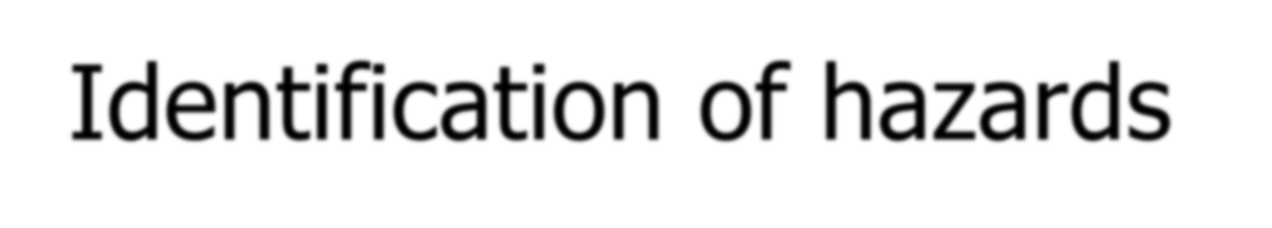

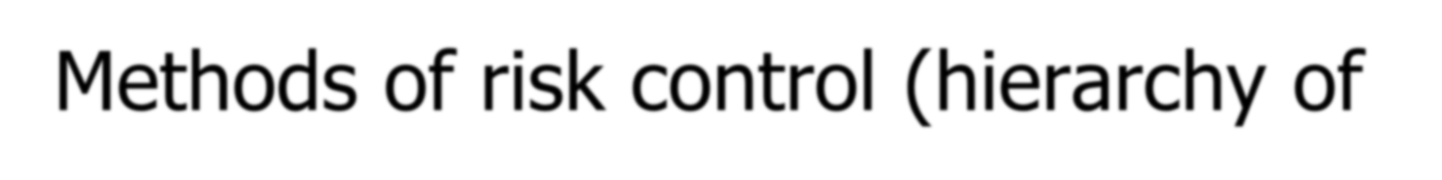
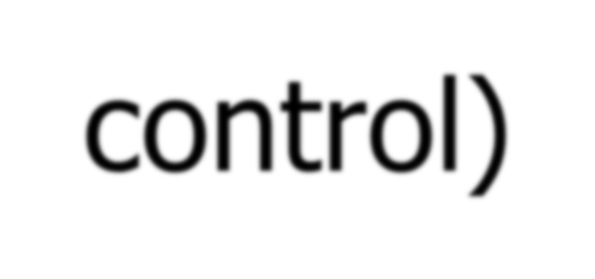

Risk Management
Process of :
Identification of hazards
Assessment of risk
Methods of risk control (hierarchy of control)
Review

Slide 4

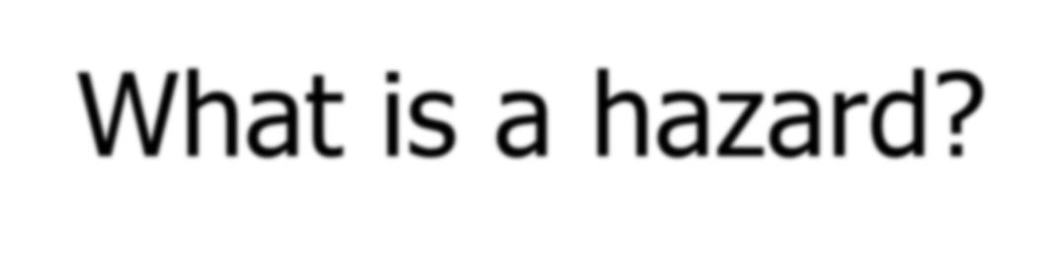



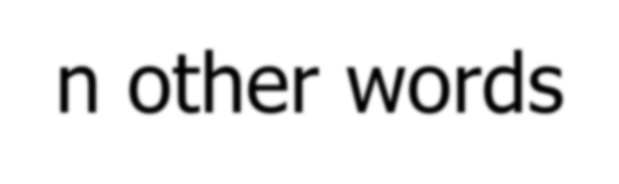
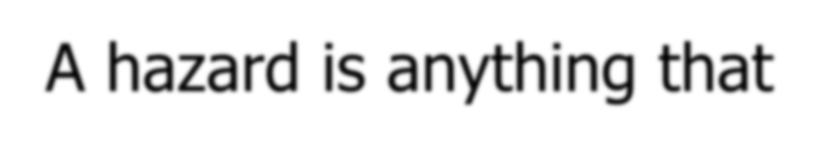
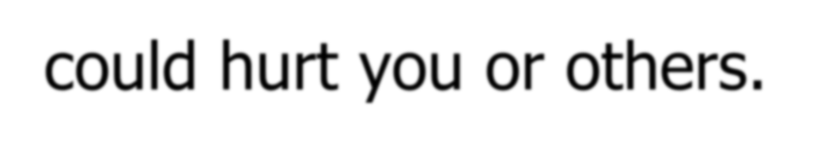
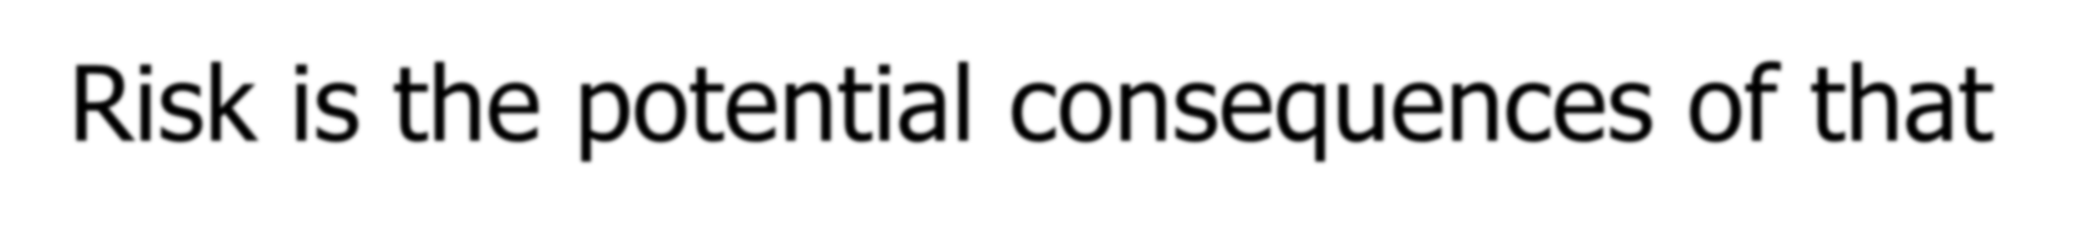

Hazard Identification
What is a hazard?
- Anything that can or has the potential to cause harm.
In other words
- A hazard is anything that could hurt you or others.
Risk is the potential consequences of that Hazard and the likelihood that it will occur!

Slide 5

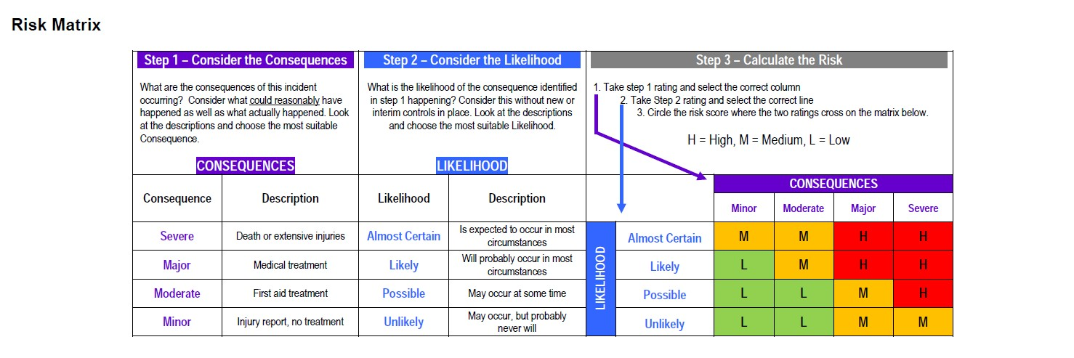
Risk Matrix

Slide 6
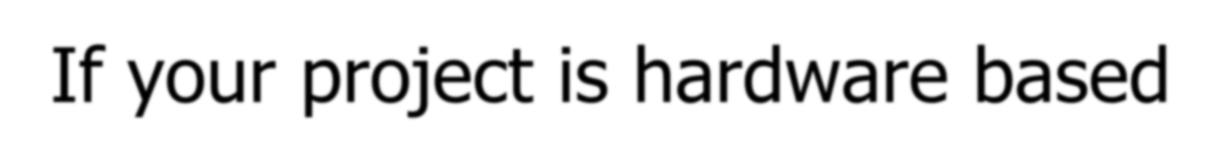
If your project is hardware based
Meet with the tutor/lecturer to discuss your project:
Feasibility of your design/project
Parts you will need to buy
Training you might need to undertake
- Select member of team to meet with Mr. Majid Munawar to develop risk assessment. Must be undertaken prior to commencing construction of project and prior to Innovation Fair.

